Slide 1

IBM Professional certificate: Supervised Learning - Classification
Ibrahim Mohamed
July 2022

Slide 2
Main objective
This analysis' primary goal is to predict the occurrence of cardiac muscle disease using various classification techniques
This investigation tries train-test-split and cross-validation to get an idea of how these two strategies can influence model selection in different ways.
Show the correlation between the features and the target predicted value and the most feature with impact on it.

Slide 3
About the disease
Predicting and diagnosing heart disease is one of the biggest challenges in the medical industry because it depends on several factors such as the patient's physical examination and various symptoms and signs. Heart disease is considered one of the most deadly diseases in the world for the human body because the heart is unable to transport the amount of blood needed to perform the normal functions of the human body to other body organs. increase.

Slide 4
About the data
The dataset used in this analysis is a dedicated to the diagnoses of heart disease to different patients
There are several factors that affect heart disease. Heart disease can be predicted based on a variety of symptoms such as age, gender, and heart rate, reducing mortality in heart disease patients. This report uses machine learning algorithms and the Python language to do this. .
This data set has 303 records and 14 variables.

Slide 5
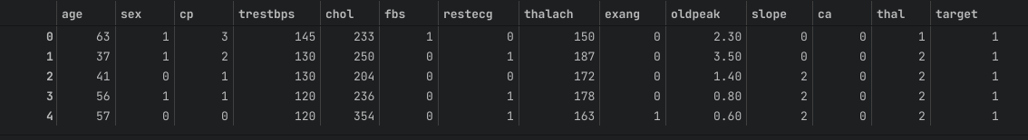
Data exploration
Features:
trestbps: resting blood pressure (mm Hg on admission to the hospital).
chol: cholesterol measurement in mg/dl.
fbs: fasting blood sugar (> 120 mg/dl) (1 = true; 0 = false).
age: patient age in years
sex: patient sex (1 = male, 0 = female)
cp: chest pain type: Value 0: asymptomatic Value 1: atypical angina Value 2: non-anginal pain Value 3: typical angina

Slide 6
Data exploration
Features:
slope: the slope of the peak exercise ST segment (0: upsloping, 1: flat, 2: downsloping)
ca: The number of major vessels (0–3)
thal: A blood disorder called thalassemia
Value 0: NULL (dropped from the dataset previously Value 1: fixed defect (no blood flow in some part of the heart) Value 2: normal blood flow Value 3: reversible defect (a blood flow is observed but it is not normal)
target: Heart disease (0 = no, 1= yes)
restecg: resting electrocardiographic results
Value 0: showing probable or definite left ventricular hypertrophy by Estes’ criteria Value 1: normal Value 2: having ST-T wave abnormality (T wave inversions and/or ST elevation or depression of > 0.05 mV).
thalach: maximum heart rate achieved.
exang: Exercise induced angina (1 = yes; 0 = no)
oldpeak: ST depression induced by exercise relative to rest (‘ST’ relates to positions on the ECG plot)

Slide 7
Data exploration
Description:
Mean
Std
Max
Min
age: 54
sex: 0.68
cp: 1
trestbps:131
chol: 246
fbs:0.15
restecg: 0.53
thalach: 149
exang: 0.33
oldpeak:1
slope: 1.40
ca:0.73
thal: 2
target: 0.5
age: 9
sex: 0.68
cp: 1
trestbps: 17
chol: 51
fbs: 0.36
restecg: 0.53
thalach: 22
exang: 0.47
oldpeak:1
slope: 0.62
ca:1
thal: 0.61
target: 0.5
age: 77
sex: 1
cp: 3
trestbps: 200
chol: 564
fbs: 1
restecg: 2
thalach: 202
exang: 1
oldpeak: 6
slope: 2
ca: 4
thal: 3
target: 1
age: 29
sex: 0
cp: 0
trestbps: 94
chol: 126
fbs: 0
restecg: 0
thalach: 71
exang: 0
oldpeak: 0
slope: 0
ca: 0
thal: 0
target: 0

Slide 8
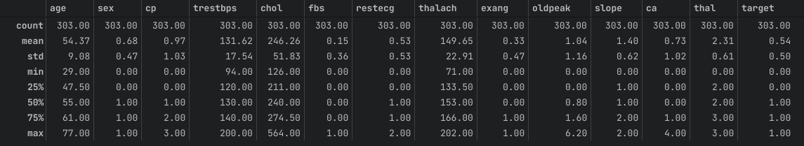
Data exploration
Description:

Slide 9
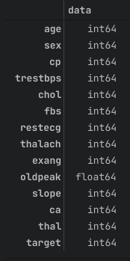
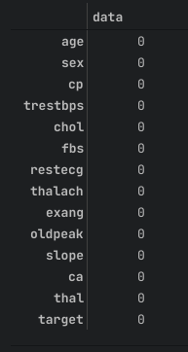
Data exploration
Data Types & Null Values
Our Data Types are the following
Our data doesn’t have any missing values as it is already a small dataset so I guess it was already cleaned before.

Slide 10
Exploratory data analysis
Categorical features & Numerical features
Our data contain both categorical features and numerical features
For our luck, the categorical data is already transformed into numerical data.
Categorical Data: sex, cp, fbs, restecg, exang, slope, ca, thal ,target
Numerical Data: age, trestbps, thalach, oldpeak

Slide 11
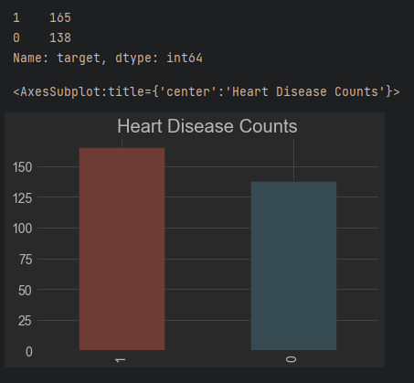
Exploratory data analysis
Disease existence in the dataset
Our data include 303 record as we said before for different 303 patient, 165 record have heart disease and 138 healthy record.
The data is almost balanced with some plus unhealthy records

Slide 12
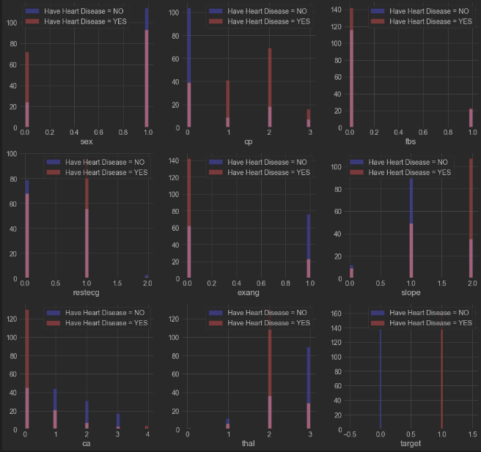
Exploratory data analysis
Categorical data correlation with target
cp (chest pain): patients with chest pain of the type: cp: [1, 2, 3] tend to have more heart disease than people without any chest pain cp: 0
restecg (resting ECG results): patients with a value of 1 (having an abnormal heart rhythm, which can range from mild symptoms to severe problems) are more likely to develop heart disease.
exang (exercise-induced angina): patients with non-exercise-induced angina who have a value of 0 are more likely to have heart disease than those who have exercise-induced angina with a value of 1.

Slide 13
Exploratory data analysis
Categorical data correlation with target
Slope (rectal slope for the ST segment of peak exercise): patients with a downsloping slope of 2 have signs of an unhealthy heart therefore they more likely to have heart disease than people with an upsloping of 0 or a flat slope A value of 1: minimal change (typical healthy heart)).
ca (number of blood vessels (0-3)): the more blood flow the better heart, so people with a vessel number ca equal to 0 are more likely to have heart disease.
thal (a blood disorder called thalassemia): patietns with a thal value = 2 are more likely to have heart disease.

Slide 14
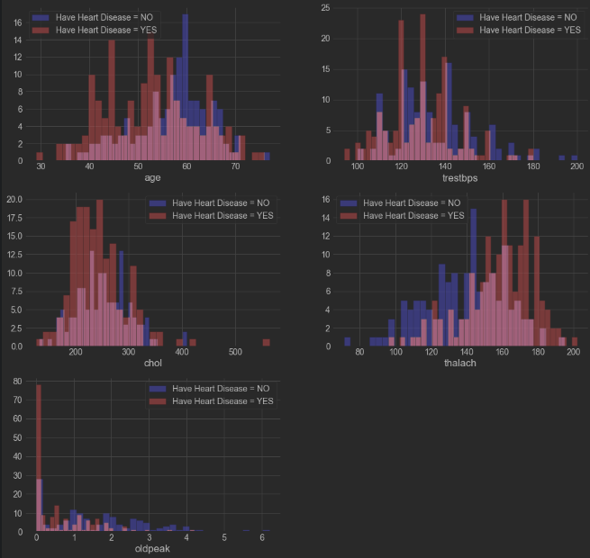
Exploratory data analysis
Numerical data correlation with target
trestbps: blood pressure higher than 130-140 mm Hg, causes concerns about having heart diseases.
chol: cholesterol higher than 200 mg/dL, is a very dangerous indicator.
thalach: People with a heart rate above 140 are more likely to have heart disease.

Slide 15
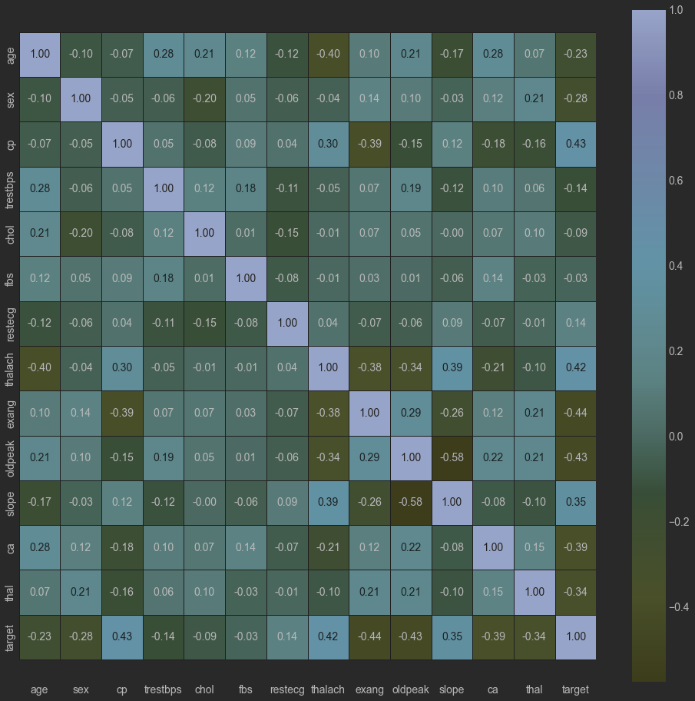
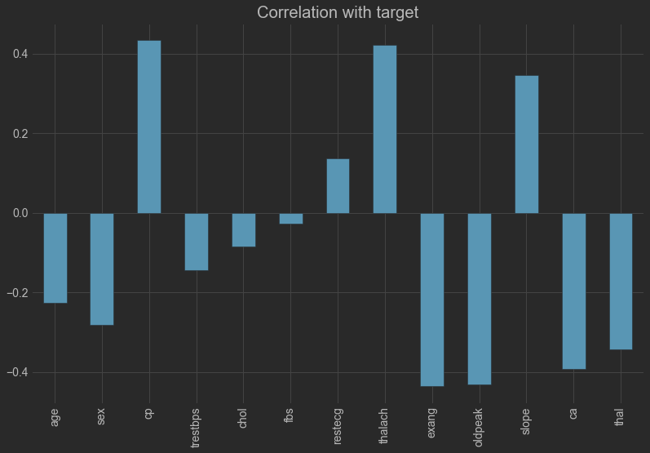
Exploratory data analysis
Correlation between features
From the heat map we notice that fbs and chol are the least features impacting the target while the other features have high correlation with the target

Slide 16
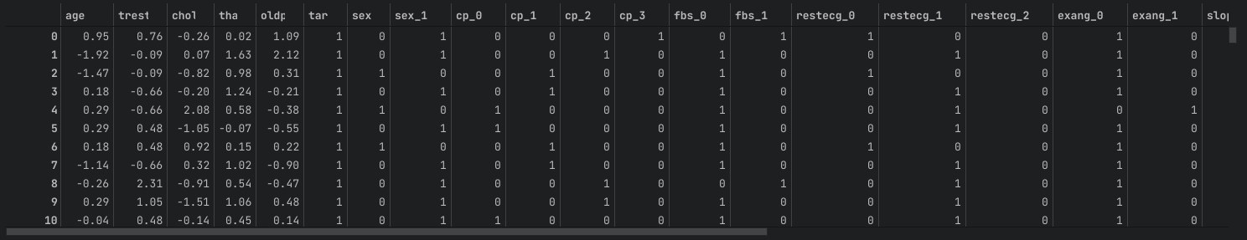
Exploratory data analysis
Feature Engineering
Converting categorical data into numerical by splitting categorise into separate columns.

Slide 17
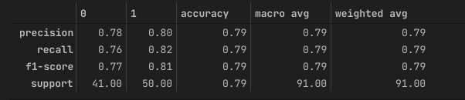
Machine learning analysis
Logistic Regression Model
Model Features and Parameters:
Model = Logistic Regression()
Solver = liblinear

Slide 18
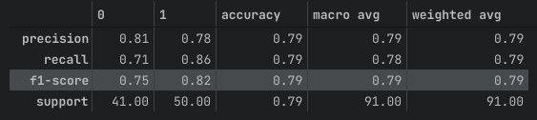
Machine learning analysis
Logistic Regression with penalty = L1
Model Features and Parameters:
Model = Logistic RegressionCV()
Cs = 10
cv: 4
penalty = l1
solver = liblinear

Slide 19
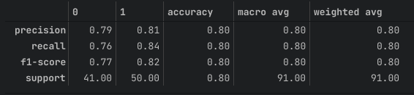
Machine learning analysis
Logistic Regression with penalty = L2
Model Features and Parameters:
Model = Logistic RegressionCV()
Cs = 10
cv: 4
penalty = l2
solver = liblinear

Slide 20
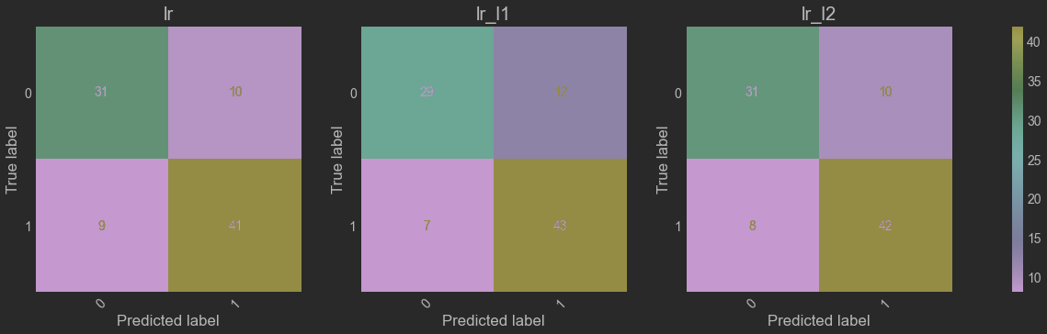
Machine learning analysis
Logistic Regression models comparison
The best model in terms of prediction performance is Logistic Regression with penalty = 2
Accuracy : 80% Precision : 80%
Recall : 80% F1-score : 80%
Support : 91%

Slide 21
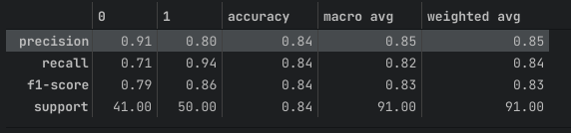
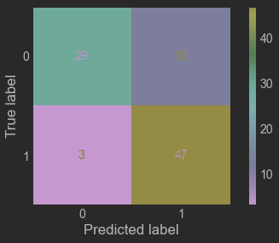
Machine learning analysis
K-Nearest Neighbors
Model Features and Parameters:
Model = KNeighborsClassifier()
n_neighbors=25
weights=distance

Slide 22
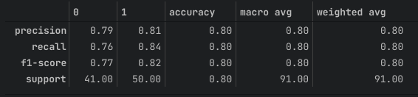
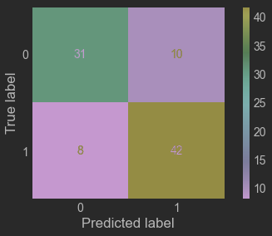
Machine learning analysis
Support Vector Machine
Model Features and Parameters:
Model = svc()
Kernel: rbf

Slide 23
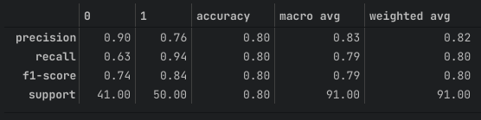

Machine learning analysis
XGBoost
Model Features and Parameters:
Model = xgb.XGBClassifer()
Objective = binary:logistic

Slide 24
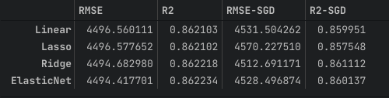
Machine learning analysis
Models Comparison
As shown in the previous analysis, all models gave very good predictions and these results are very close, but in the end to choose the best model of dataset that has the best results.
Here is the order according to the best four models:
KNN
XGBoost
Logistic Regression with L2
Support Vector Machine

Slide 25
Analysis Next Steps
Models Flaws and Strength and further suggestions
From a simplicity point of view, logistic regression yields high predictive results and at the same time is the simplest and fastest model in terms of parameters and training, but looking at other models like KNN, it provides the best results.
However, it is time consuming from the perspective of the prediction process, as the distances between all the points in the dataset must be calculated to classify the individual points. XGBoost also performed very well, but unlike KNN, it uses a grid search technique to find the best parameters, which takes a long time in the training process. So, in the end, if you have a larger dataset, there is a trade-off. The performance of such models is high, but the training process is time consuming.

